Slide 1
Group 35 Student Society Event Planner
ECM1413 – Data Structures and Algorithms
Max Thrift-Brothers
Cameron Russel

Slide 2
The Problem:
A university society has a restricted amount of time and money, its aim to give the most enjoyment to its members whilst sticking to a time and or budget.
This program takes in a list of activities and solves this problem two different ways to provide a subset that maximises enjoyment whilst sticking to a budget

Slide 3
Brute force approach:

Slide 4
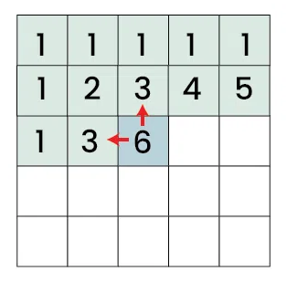
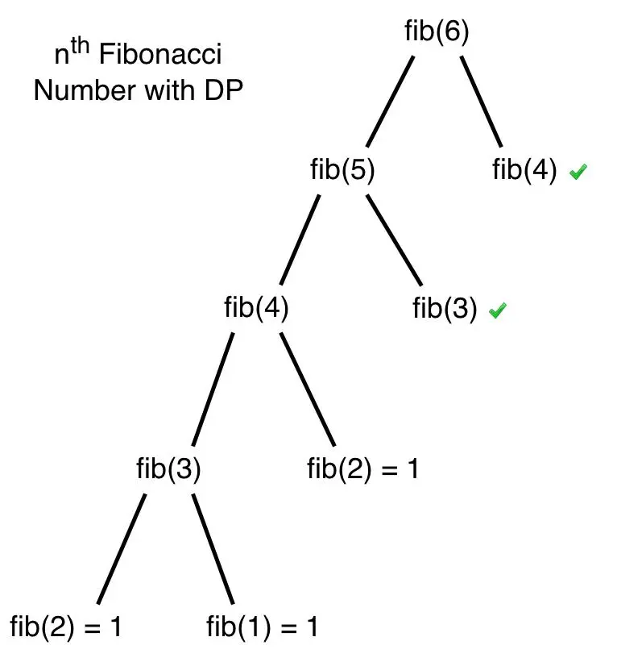
Dynamic Programming Approach:
This method uses a 2D array to store each computed value and uses them to compute the next values.
Reducing the time complexity
Pros – Quicker Computation time, guaranteed solution
Cons – More complex implementation, needs more memory

Slide 5
Demonstration:

Slide 6
Conclusion:
Results
Overall, both methods work equally for small datasets of sizes up to 12.
Anything larger creates a larger time difference and at size 100 the brute force algorithms times out.
Even with a size of 1000 the DP method stills computes in 0.3 seconds
Challenges
Learning to collaborate on GitHub
Keeping to correct python formalities, variable names, comments etc

Slide 7
References:
Slide 4 - https://www.geeksforgeeks.org/competitive-programming/dp-on-grids/
Slide 4 - https://theoryofcoding.com/index.php/2015/03/02/dynamic-programming-introduction-and-fibonacci-numbers/

